Slide 1
DS6306 Live Session 11
By Ben Goodwin

Slide 2
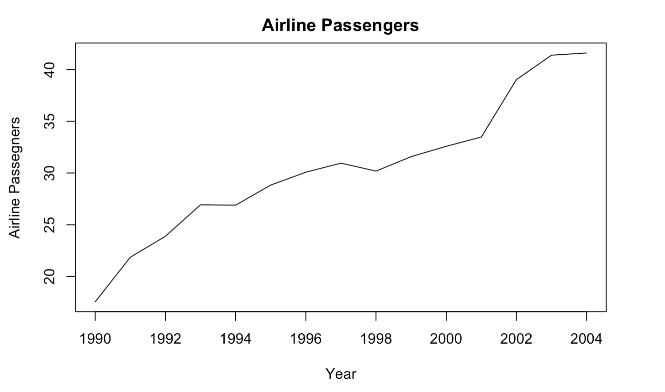
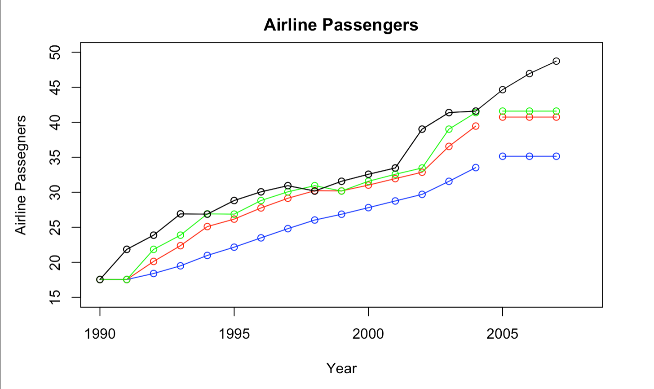
Question 1, Simple Exponential Smoothing
H-The number of forecasting periods (important for question 4)
Alpha-Value of smoothing parameter for the level
Simple-the initial values are set to values obtained using simple calculations on the first few observations.
The SES models have different alpha levels and additionally the first two initial values are based on the first few observations.

Slide 3
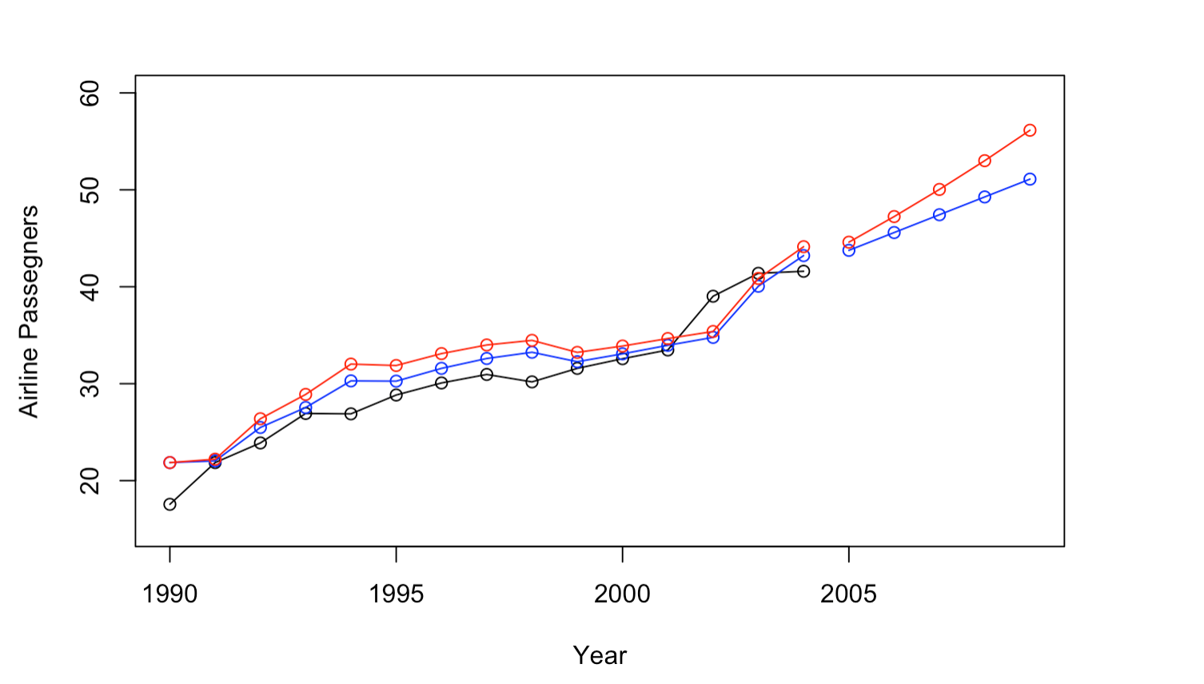
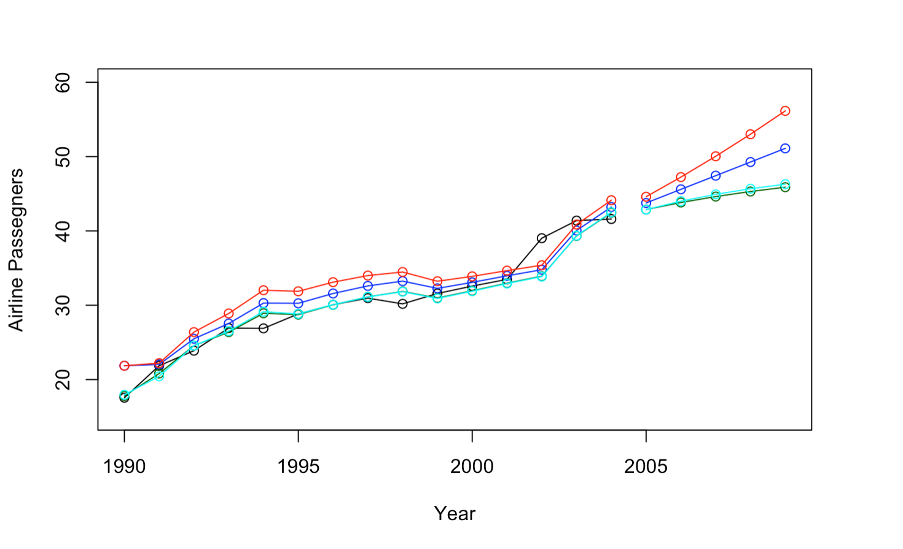
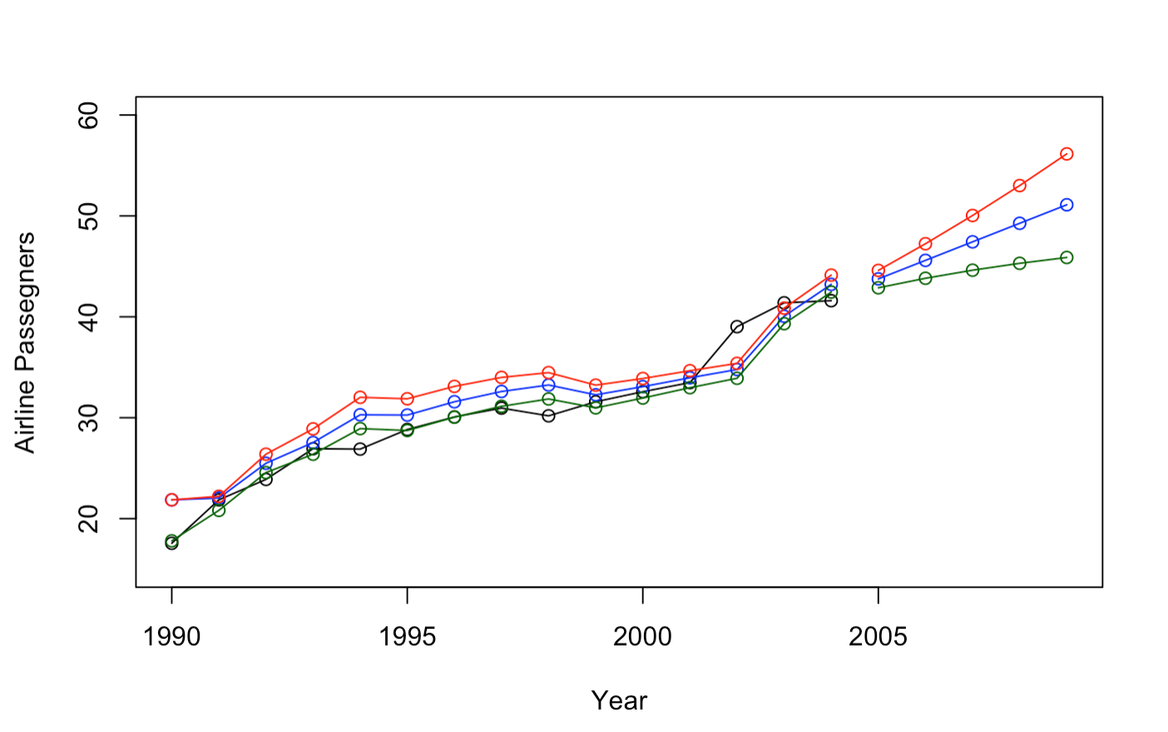
Question 2, Holt Linear Trend Model
The Holt Linear Trend Model extends exponential smoothing to allow the forecasting of data with a trend.
Model 1
Model 3
Model 2

Slide 4
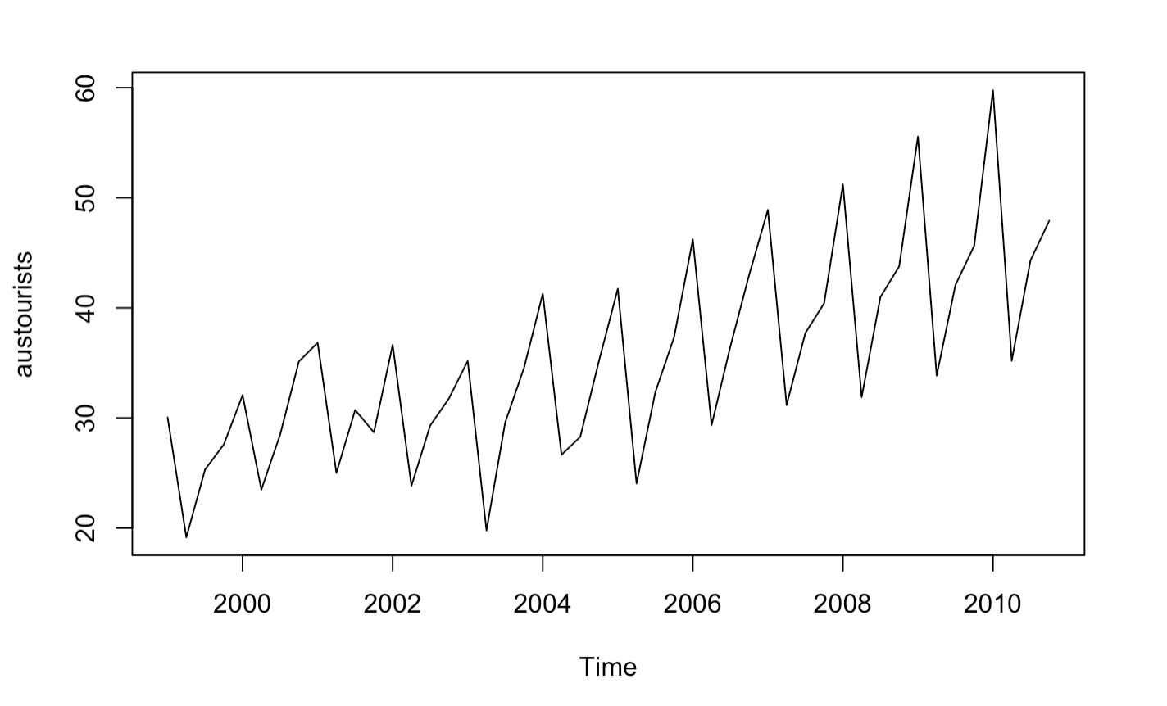
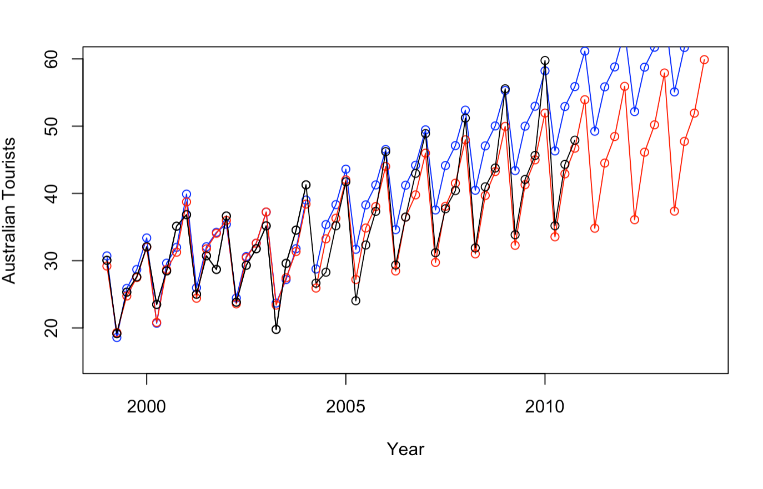
Question 3, Seasonal Trends

Slide 5
Question 4, Full Analysis
R Input:
# 1. SES MODEL FOR Max temp
data("maxtemp")
#returns a ts object
air = window(maxtemp, start = 1990, end = 2015)
# Always plot the data first!
plot(air,ylab = "Temperature", xlab = "Year", main = "Maximum Temperature")
#fit 3 different simple exponential smoothing models ... how are they different?
fit1 = ses(air, initial = "simple",alpha = .2,h = 5)
# the forecast package has a nice accuracy funciton with various metrics just pass it the
# the model and the data! (This is the "training" data)
accuracy(fit1, maxtemp)
air2008 = window(maxtemp, start = 1990, end = 2010)
plot(air2008)+(points(air2008, type = "o"))
#Reset the plot
plot(air,ylab = "Temperature", xlab = "Year", type = "o", xlim = c(1990, 2021),ylim = c(15,50), main = "Maximum Temperature")
#Plot the estimated values from the models .. the "fitted" values are the training values.
lines(fitted(fit1), col = "blue", type = "o")
# the $mean values are the forecasts.
lines(fit1$mean, col = "blue", type = "o")
# These are the actual values! Compare visually with the forecasts!
air2008 = window(maxtemp, start = 1990, end = 2021)
plot(air2008)+points(air2008, type = "o")
# Compare the forecasts with the actual values with various fit metrics.
accuracy(fit1, air2008)

Slide 6
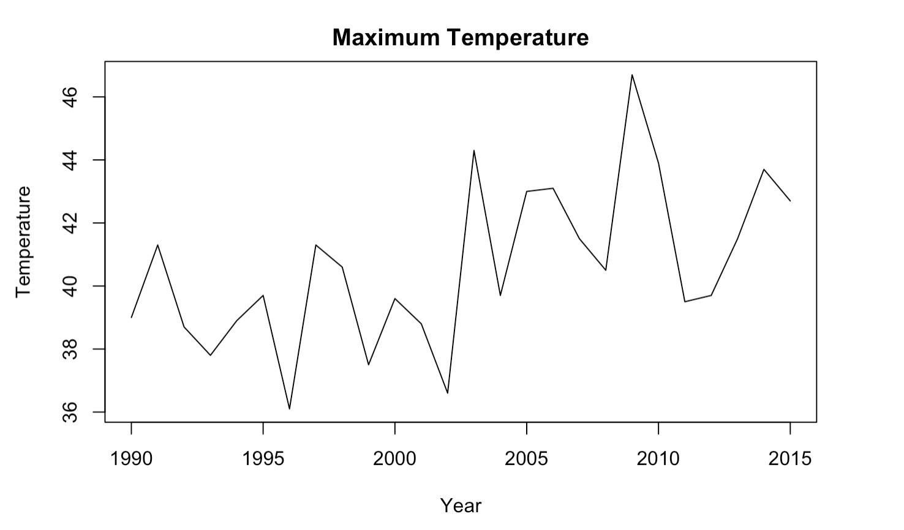
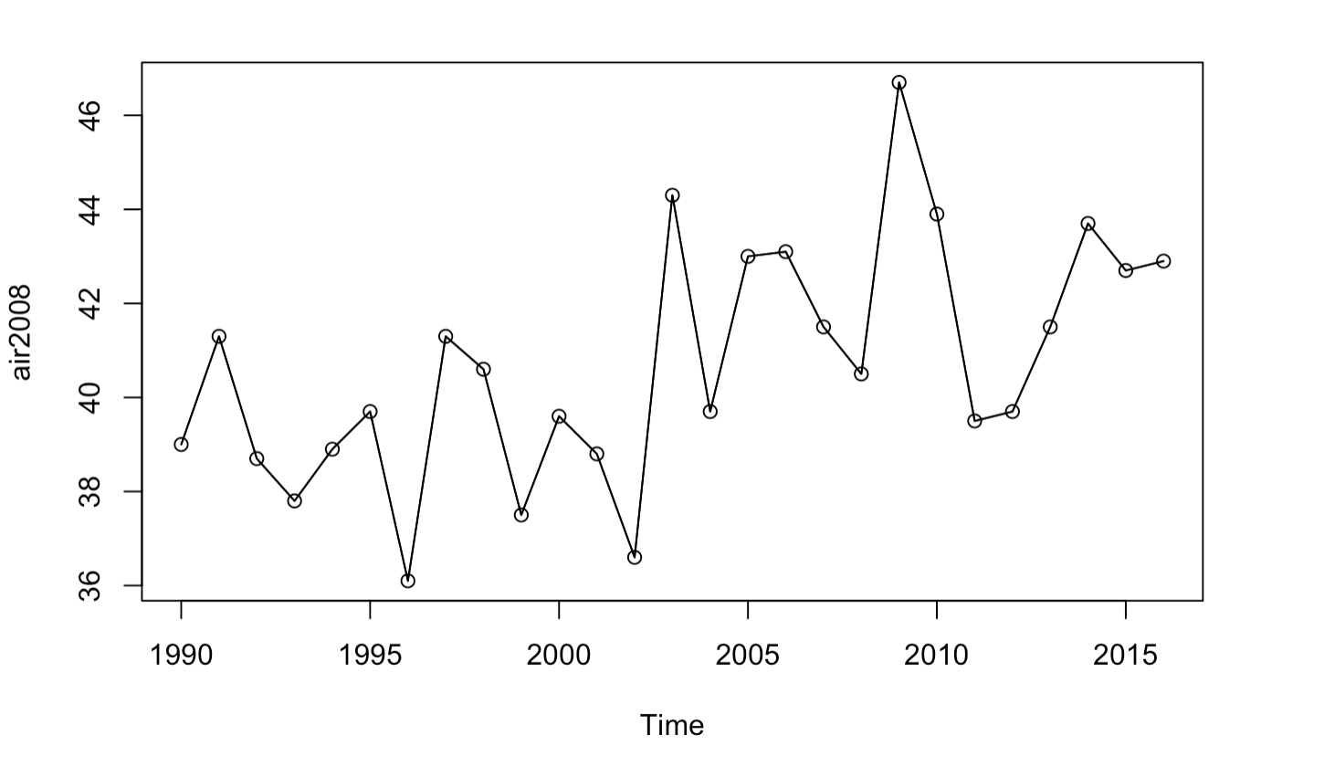
Question 4, Full Analysis
Temperature EDA

Slide 7
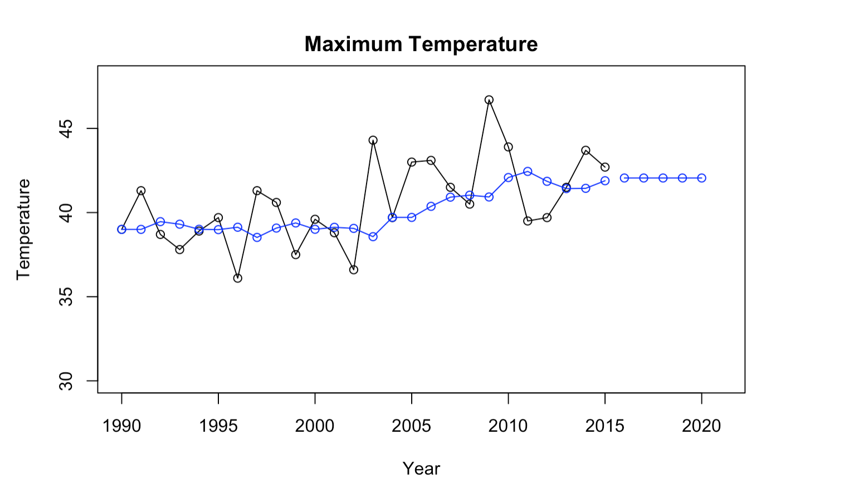
Question 4, Full Analysis
Forecasted Temperatures

Slide 8
Question 4, Full Analysis
R input:
#2 Holt's Linear Trend Model for maxtemp
fit1h = holt(air, alpha = .8, beta = .2, initial = "optimal", h = 5)
# Check out estiamted values of the "training" data from the first holt model
fitted(fit1h)
# Check out the forecast value (h of them)
fit1h$mean
# Reset the Plot!
plot(air,ylab = "Temperature", xlab = "Year", type = "o", xlim = c(1990, 2021),ylim = c(35,48))
#Plot each models estimated values of the training data (Do these one by one to see the differences)
lines(fitted(fit1h),col = "blue", type= "o")
#Plot each models forecasts (Do these one by one to see the differences)
lines(fit1h$mean, col = "blue", type= "o")

Slide 9
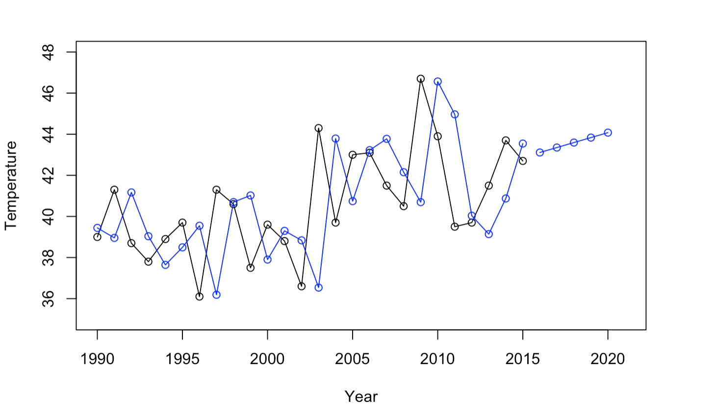
Question 4, Full Analysis
Forecasted Temperatures for Holt

Slide 10
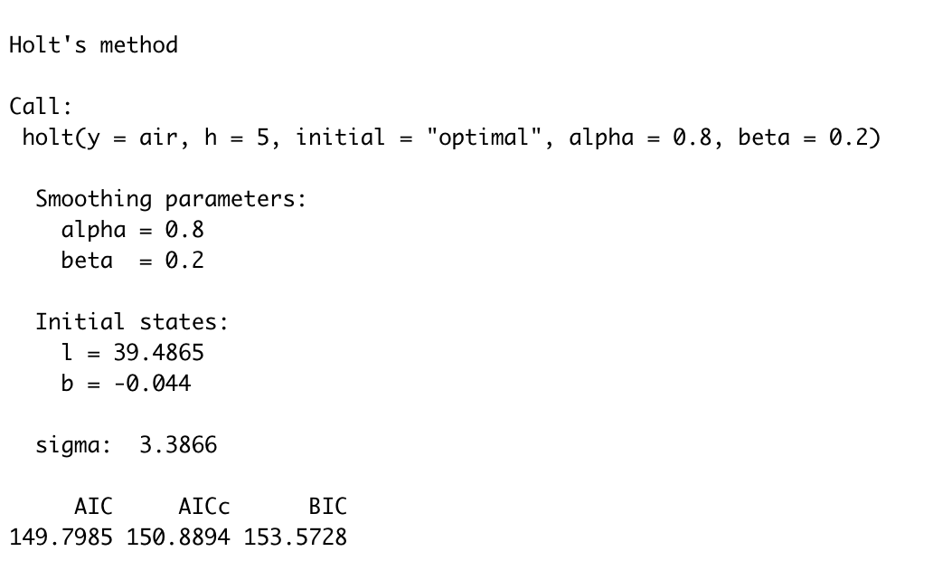
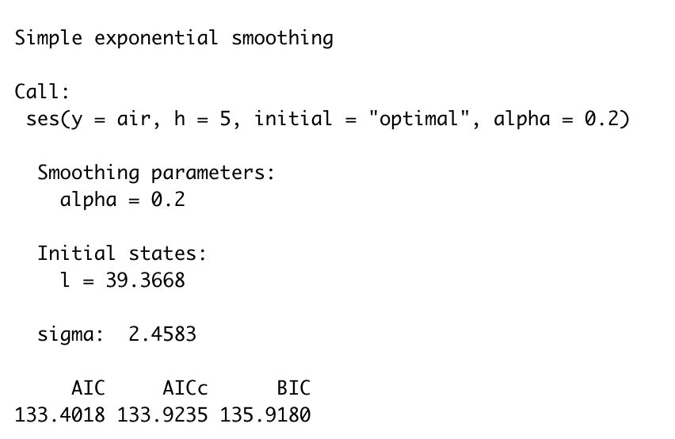
Question 4, Full Analysis
AIC and BIC Holt and SES
AIC and BIC Holt
AIC and BIC SES
Due to the lower value for AICc and BIC the simple exponential smoothing method appears to be closer to the truth.

Slide 11
Question 4, Full Analysis
SES:
Results
The SES method again wins here, the MASE < MASE (Holt).
It’s important to note that both are <1.
Holt:

